Slide 1
KIT COEK
Web Technology 1
By Suhas Mane.

Slide 2
XSL - Family
XSL - Fmaily
Transformation Language
Formatting Language
JAXP supports XSLT

Slide 4
<?xml version = “1.0” ?>
<?xml-stylesheet type = “text/xsl” href = “product.xsl” ?>
<PRODUCTDATA>
<PRODUCT>
<PRODID id = “P001”></ PRODID >
<PRICE> 300.00 </PRICE>
</PRODUCT>
< PRODUCT>
<PRODID id = “P002”> </PRODID>
<PRICE> 900.00 </PRICE>
</ PRODUCT >
< PRODUCT>
<PRODID id = “P003”> </PRODID>
<PRICE> 400.00 </PRICE>
</ PRODUCT >
</PRODUCTDATA>

Slide 5
<xsl : template>
Defines a template for producing output
name | value
match (optional) | Pattern
name (optional) | Name
priority (optional) | Number
Attributes of <xsl : template>

Slide 6
product.xsl
<?xml version = “1.0” ?>
<xsl : stylesheet
xmlns : xsl = “http://www.w3.org/1999/XSL/
Transform” version = “1.0”>
<xsl : template match=“/”>

Slide 7
<table border = “1”>
<tr>
<th>Product Id</th>
<th>Price</th>
</tr>
<xsl : for-each select = “PRODUCTDATA / PRODUCT”/>
<tr>
<td><xsl : value-of select = “PRODID / @*”/></td>
<td><xsl :value-of select = “PRICE”/></td>
</tr>
</xsl :for-each>
</table>

Slide 8
</ xsl : template>
</ xsl : stylesheet>

Slide 9
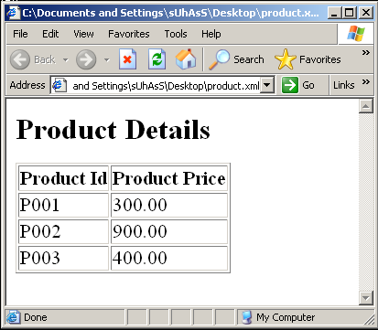
product.xml : output in browser IE

Slide 10
<xsl : apply-templates>
It selects a set of nodes and process each of them by finding a matching template
name | value
select (optional) | expression
Attributes of <xsl : apply-templates>

Slide 11
product.xsl
<?xml version = “1.0” ?>
<xsl : stylesheet
xmlns : xsl = “http://www.w3.org/1999/XSL/
Transform” version=“1.0”>
<xsl : template match = “/”>
<xsl : apply-templates />
</ xsl : template>

Slide 12
<xsl : template match = “PRODUCT”>
<p>
<xsl : apply-templates select = “PRODID” />
<xsl : apply-templates select = “PRODNAME” />
</p>
</xsl : template>

Slide 13
<xsl : template match = “PRODID”>
Product Id : <xsl : value-of select=“. / @id” />
<br />
</xsl : template>
<xsl : template match = “PRODNAME”>
Product Name : <xsl : value-of select=“.” />
<br />
</xsl : template>
</ xsl : stylesheet>

Slide 14
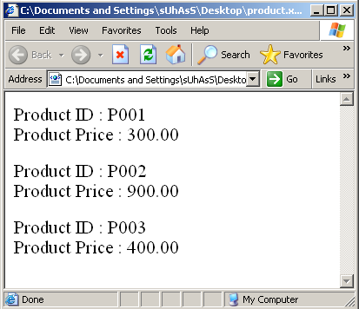
product.xml : output in browser IE

